Slide 1
SAP HANA Administration Tools

Slide 2
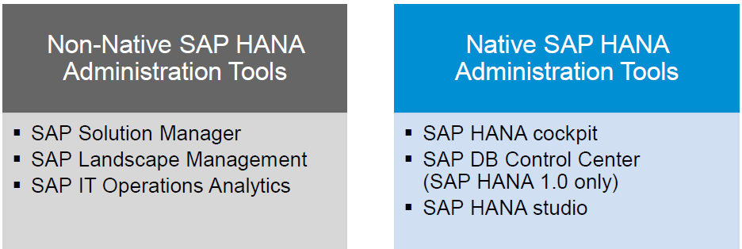
SAP HANA Admin Tools
Administrators of SAP HANA systems need to know about the tools for administration and monitoring, how they are integrated with SAP HANA, and what their capabilities are.
Previously. the most common tool was the SAP HANA studio, but. with SPS09, the SAP HANA Cockpit is used increasingly.
Because several tools are available for administration of SAP HANA. it is important to know the differences between these tools

Slide 3
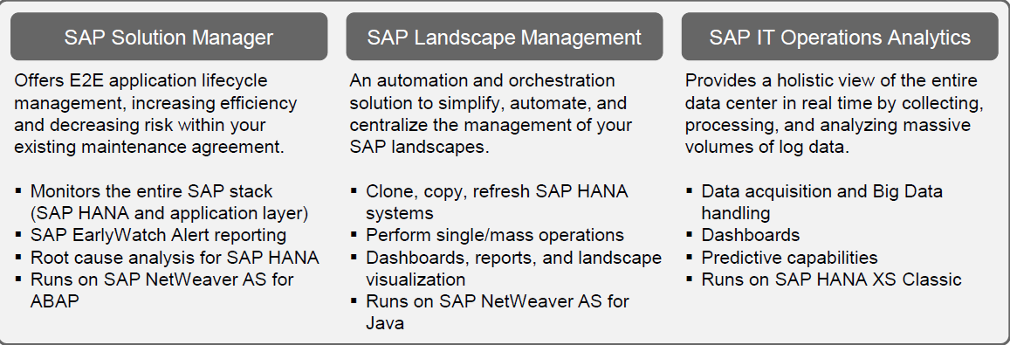
Non-native SAP HANA administration tools

Slide 4
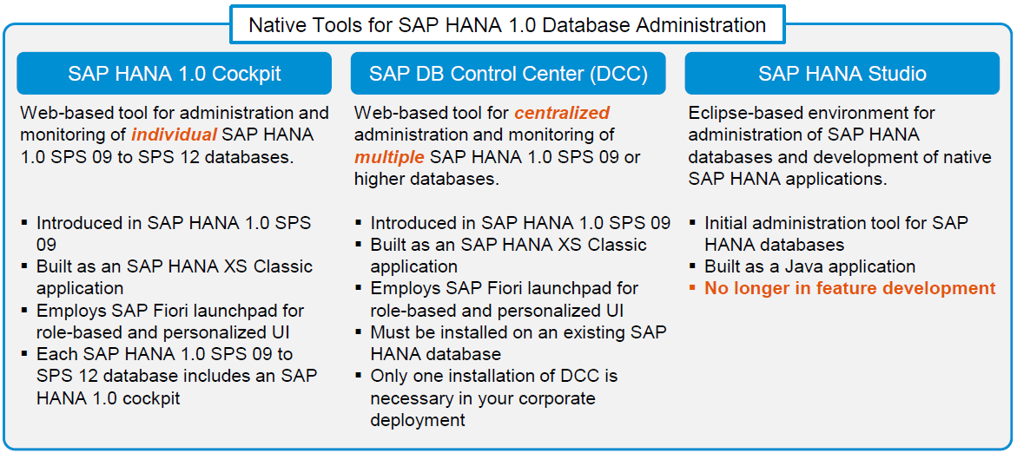
Native SAP HANA administration tools – SAP HANA 1.0

Slide 5
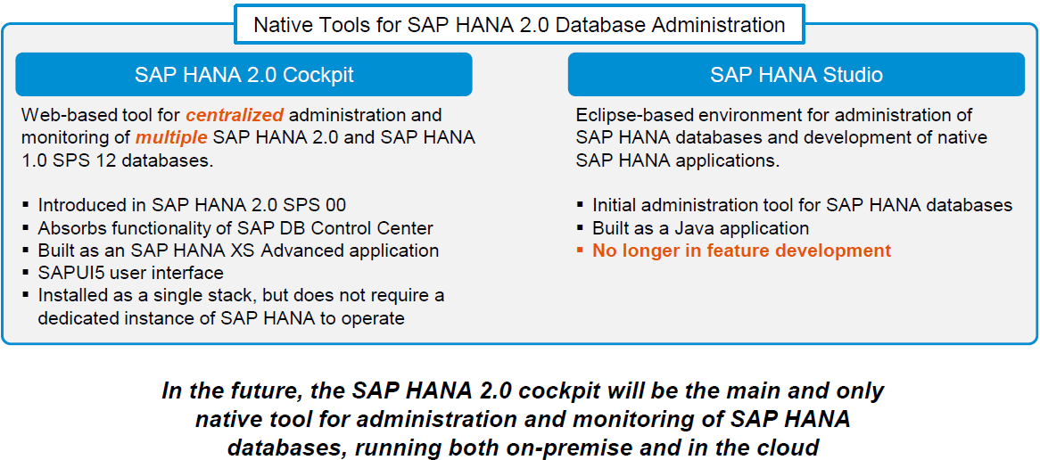
Native SAP HANA administration tools – SAP HANA 2.0

Slide 6
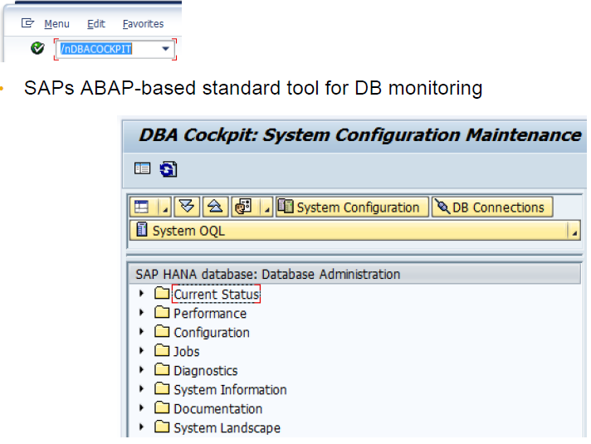
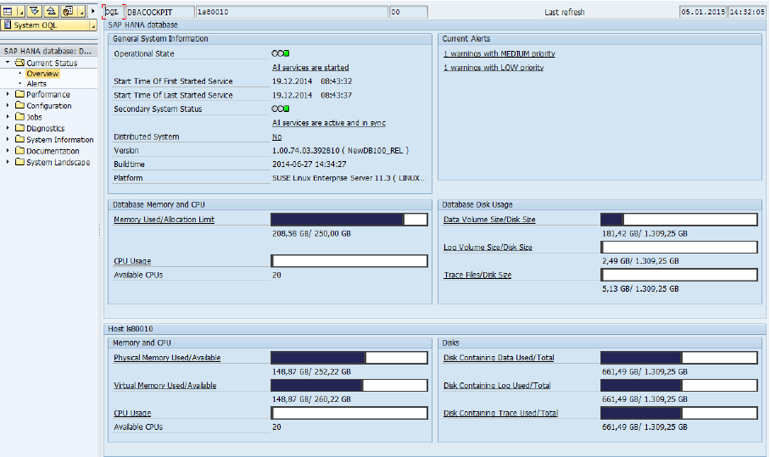
DBACOCKPIT

Slide 7
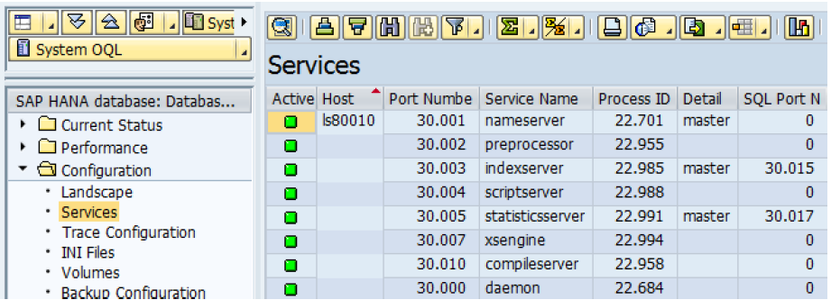
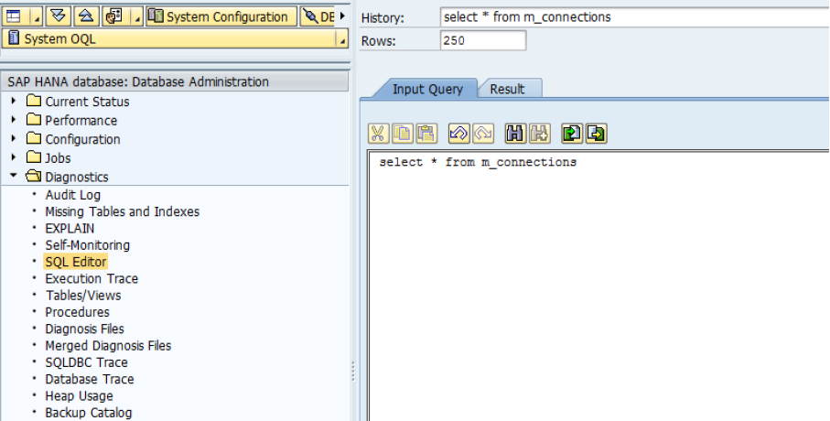
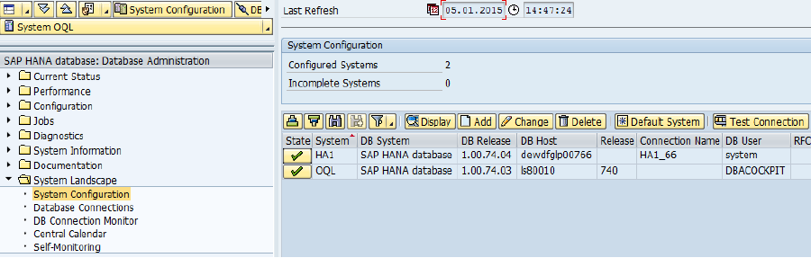
DBACOCKPIT

Slide 8
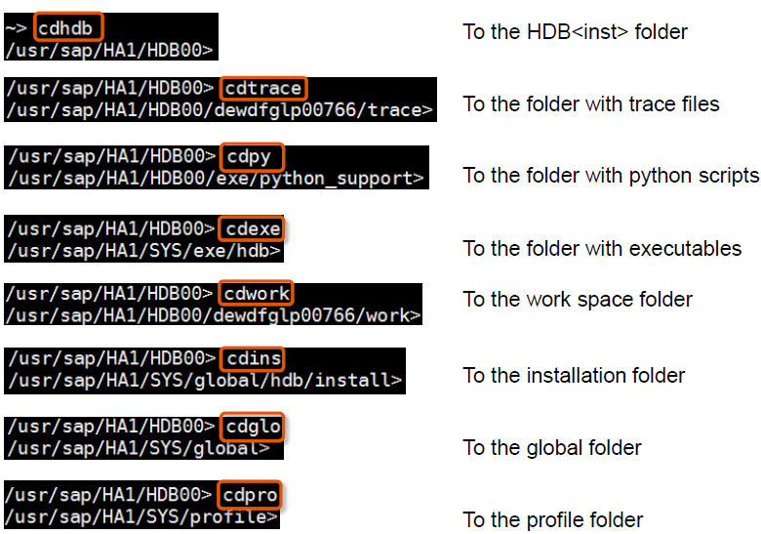
OS Level Tools Shortcuts

Slide 9
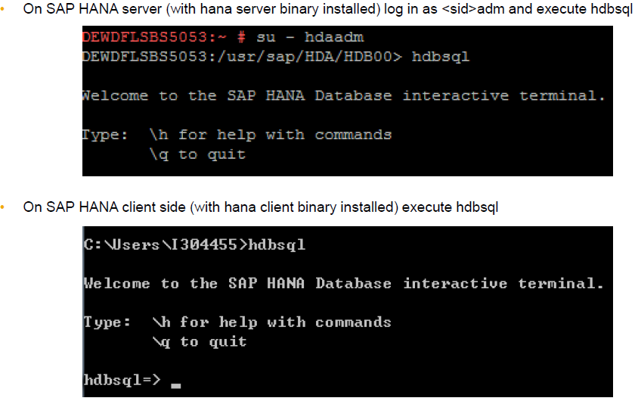
hdbsql
• SAP HANA HDBSQL is a command line tool for executing commands on SAP HANA databases, like
Execute SQL statements and database procedures
Query information about database and db objects
HDBSQL is a component of the SAP HANA software
HDBSQL can access databases both locally and remotely
Suitable to develop scripts for automation

Slide 10
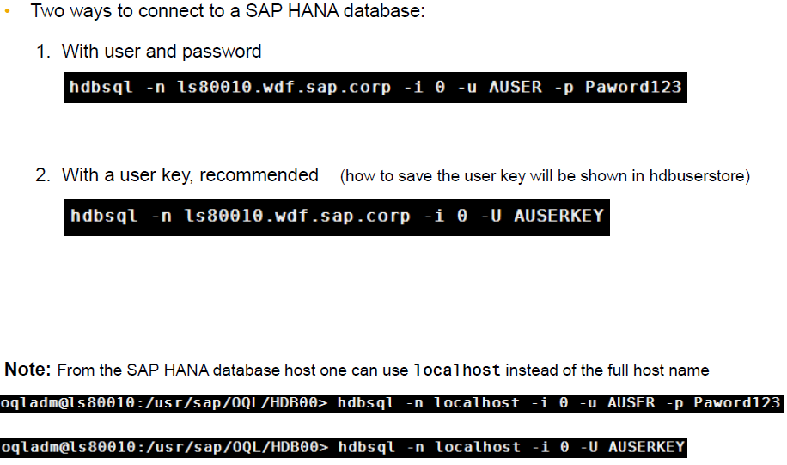

Slide 11
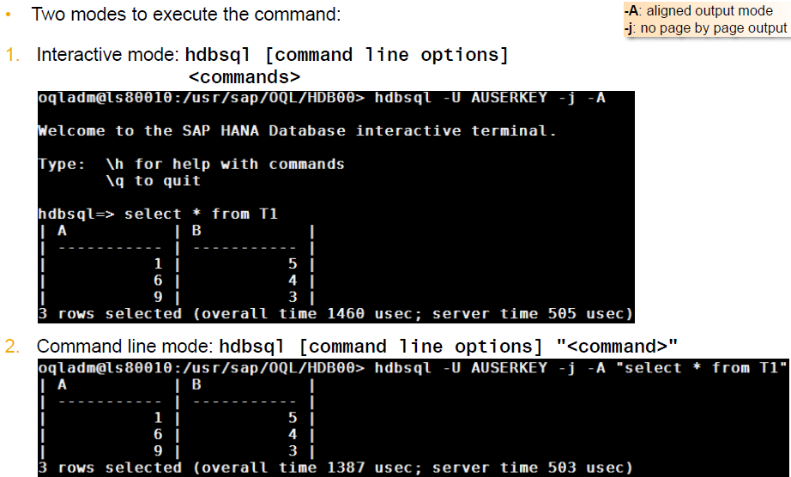
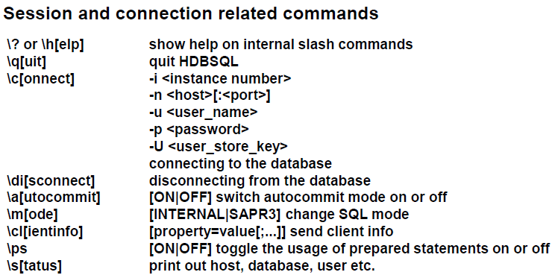

Slide 12
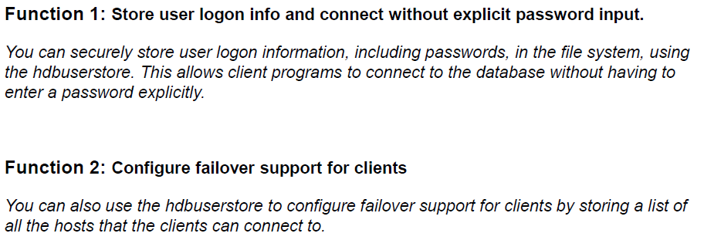
hdbuserstore

Slide 13
